Slide 1
Overview of Infrastructure Trials for New Test Coordinators –Part II
Note: This is a 2-part training, and if you did not participate in Part I yesterday, the slides and recording from that session will be posted on the Training page of the MCAS Resource Center (mcas.pearsonsupport.com/training/) in about a week.
The Office of Student Assessment Services January 26, 2024

Slide 2
Presenters
Shannon Cullen, Test Administration Coordinator
Joseph Henkelman, Pearson Technical Support
Matthew Ingles, Pearson Customer Support

Slide 3
Logistics for This Session
Use the Q&A feature to ask a question.
We will answer some questions aloud at specified times during this training session, and we will email the Q&A afterwards.
Type your questions anytime, but we may not answer them in real time as some questions may be covered during the presentation.
Use the thumbs-up icon to “upvote” someone else’s question.
Email student-specific questions to mcas@doe.mass.edu instead of asking here.
This session is being recorded and will be available in about a week in the MCAS Resource Center, along with the slides.
Slides were also emailed out beforehand, and are being posted in the chat.
Closed captioning has been enabled for participants who need it.
This session is being interpreted into ASL. Our interpreting team will be onscreen with the presenters.

Slide 4
Slides for This Session
Slides were emailed to participants before this session from MCASEvents@cognia.org.
Slides are now being posted in the chat.
If you cannot access the slides in the chat, ask in the Q&A.
After the session, we will send the slides again to participants, and they will be posted in the MCAS Resource Center along with the recording.

Slide 5
Today’s Agenda
Review: Part I of Infrastructure Trials for New Principals and Test Coordinators
Checklist of Steps: Tasks for Test Coordinators and Test Administrators
Administration and Next Steps
Resources, Support, and Next Steps
Live “Sandbox” Time

Slide 6
1. Review: Part I of Infrastructure Trials for New Principals and Test Coordinators

Slide 7
Poll Question
Did you participate in yesterday’s training session, Infrastructure Trials for New Principals and Test Coordinators: Part I?
Yes
No

Slide 8
Yesterday’s Agenda
Determining Whether to Run an Infrastructure Trial
Introduction to Infrastructure Trials
Checklist of Steps: Tasks for Test Coordinators and Test Administrators
Resources, Support, and Next Steps
Live “Sandbox” Time

Slide 9
Recommended Windows to Conduct Preliminary System Tests/Infrastructure Trials
Grades | Recommended Windows
March Retests | January 29 – February 23
Grades 3–8 | January 29 – March 15
Grade 10 ELA | February 5 – March 18
June High School Science | April 22 – May 24
Note that there is no recommended Infrastructure Trial window for grade 10 Mathematics. If a school successfully completes grade 10 ELA CBT testing, and their technology does not change, they may not need to conduct additional Infrastructure Trials.
Note that there is no recommended Infrastructure Trial window for the Grade 8 Civics Field Test. Test administrators who wish to practice completing tasks in PAN may use the Spring 2024 MCAS Gr. 3–8 administration in the PAN training site
Schools may choose to complete an Infrastructure Trial for high school Science if they have students and staff who have not yet participated in CBT.

Slide 10
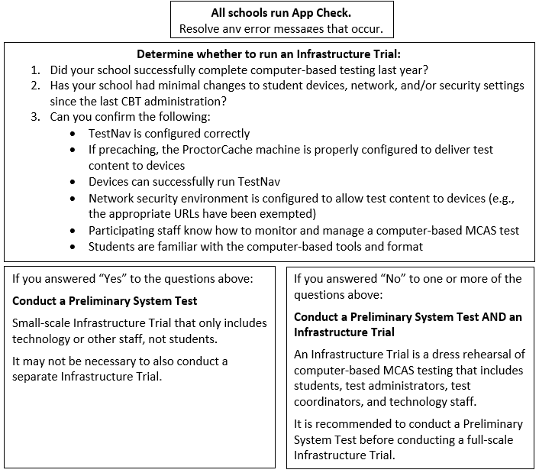
Determine Whether to Run an Infrastructure Trial

Slide 11
Task | What is it? | Should my school complete this task? | Who participates? | Confirms that:
App Check | App Check is completed in TestNav after configuring the network and downloading TestNav on student devices. | Yes, all schools should complete App Check. | Technology staff | Devices can successfully run TestNav TestNav is configured correctly
Preliminary System Test | Small-scale Infrastructure Trial completed by technology or other school staff, during which staff log in to TestNav on student devices and click through practice tests. | Strongly recommended for schools not conducting Infrastructure Trial. Recommended for schools conducting Infrastructure Trial. | Technology or other school staff | Devices can successfully run TestNav TestNav is configured correctly Network security environment is configured to allow test content to devices (e.g., the appropriate URLs have been exempted)
Infrastructure Trial | Simulated testing experience during which one or more practice test sessions are administered. | Guidance on whether to conduct an Infrastructure Trial is outlined on slide 8. | Students, teachers, technology staff, test coordinators | Devices can successfully run TestNav TestNav is configured correctly Network security environment is configured to allow test content to devices (e.g., the appropriate URLs have been exempted) If precaching, the ProctorCache machine is properly configured to deliver test content to devices Participating staff know how to monitor and manage a computer-based MCAS test Students are familiar with the computer-based tools and format.

Slide 12
Main Steps for the Infrastructure Trial
Technology Coordinators:
Set up and configure ProctorCache and/or Secondary Save locations in PAN.
Set up and configure network to make sure the appropriate URLs are exempted.
Ensure that the current version of TestNav is installed on testing devices and that device OS versions are supported by TestNav.
Test Coordinators: Generate sample students, create PAN Sessions, and assign students to Sessions in the PAN training site.
Test Coordinators: Assign any accommodations that students may need to try out in the Trial.
Test Administrators: Administer practice tests to students using TestNav and manage those sessions in PAN during testing.
MCAS Testing Team: Conduct follow-up activities and review lessons learned with the test administration team based on your school’s circumstances.

Slide 13
PAN Steps to Prepare for the Infrastructure Trial
Generating sample students
Creating PAN Sessions
Updating a student record
Adding an accommodation to a sample student
Adding a student to PAN Session
Creating/editing Human Reader/Human Signer Sessions
A recording of yesterday’s session will be posted to the MCAS Resource Center within one week.

Slide 14
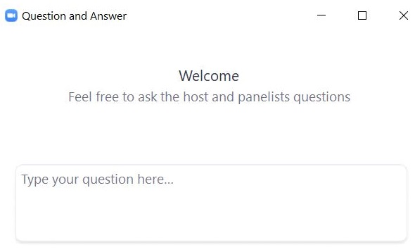
Questions and Answers
Use the “Q&A” feature to ask questions.

Slide 15
2. Checklist of Steps: Tasks for Test Coordinators and Test Administrators

Slide 16
Overview of Steps for Test Coordinators
View training modules (mcas.pearsonsupport.com/training/)
Assemble an Infrastructure Trial team to carry out all the required tasks.
Identify students who will participate.
It is recommended that schools select the maximum number of staff and students who will be using network resources at the same time, so that the trial approximates the maximum anticipated network load.
Train all staff involved in the Infrastructure Trial.
Designate appropriate testing schedule, locations, and devices.
Consult with the technology coordinator and confirm that all devices meet the technology specifications.

Slide 17
Overview of Steps for Test Coordinators (continued)
Covered during Part I (yesterday)
Covered during Part II (today)
Generate sample students.
Edit student records (if needed).
Assign student tests.
Create/Edit PAN Sessions.
Prepare/Start PAN Sessions.
Print student testing tickets, and print proctor testing tickets for students in Human Read-Aloud and Human Signer PAN Sessions.
Mark tests complete.
Stop PAN Sessions.
Convene your team prior to operational testing to resolve any issues you encountered.

Slide 18
Overview of Steps for Test Administrators
View training modules (mcas.pearsonsupport.com/training/)
Confirm students have the correct test form assigned by using the Session Student Roster (recommended)
Start, Stop, and Resume student tests in PAN
Lock and Unlock PAN Sessions
Monitor student progress in the PAN Sessions
Close down testing devices
Covered during Part I (yesterday)
Covered during Part II (today)

Slide 19
Demonstrations
Prepare Sessions
Start PAN Sessions

Slide 20
Prepare/Start PAN Sessions
Note: During operational/live testing, schools should plan to prepare and start PAN Sessions according to the following timeline:
Prepare PAN Sessions up to two days prior to testing
Start PAN Sessions no more than one day prior to testing

Slide 21
Prepare PAN Sessions
PAN Sessions must be prepared by the test coordinator before they can be started. This step assigns the test forms to the students.
Testing > Students in Sessions > Find the PAN Session and select the checkbox to see the Session Details screen. Click the blue Prepare Session button.

Slide 22
Start the PAN Session
After you have prepared your PAN Session, you will see a green Start Session button on the Students in Sessions page. Click that to start the PAN Session.
Once started, a Session cannot be stopped until all students are in Complete or Marked Complete status.

Slide 23
Demonstrations
Accessing Session Student Roster
Printing Testing Tickets
Student Testing Ticket vs. Proctor Testing Ticket

Slide 24
Session Student Roster
The Session Student Roster is available in PAN.
After Sessions have been prepared, test administrators should review the Session Student Roster prior to beginning testing to ensure that students are assigned the appropriate test forms for accommodations.
Indicator | Description
TTS | Text-to-speech
SR | Screen Reader
AT | Compatible Assistive Technology
ASL | American Sign Language
S | Spanish/English
Calc | Calculation device on a non-calculator section
WebX | Web Extensions

Slide 25
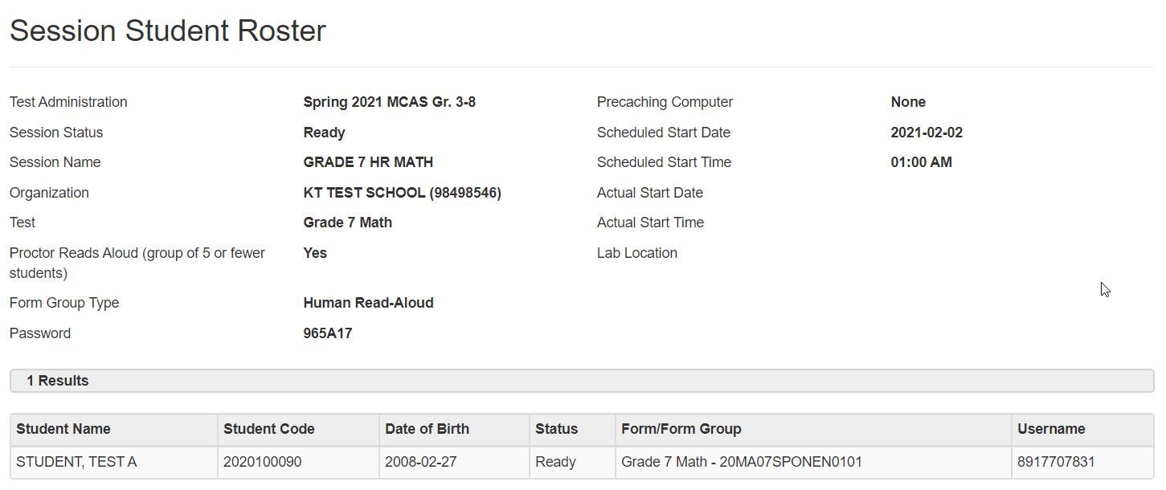
Sample Session Student Roster (Students in Sessions > Resources)

Slide 26
Poll Question
During operational testing, when should you print student testing tickets?
Up to two weeks before testing
Up to one week before testing
Up to two days before testing
Up to one day before testing

Slide 27
Print Testing Tickets
Note: During operational/live testing, schools should print, cut, and sort student testing tickets up to two days before testing.
Steps to prepare student testing tickets can be found at support.assessment.pearson.com/x/HxpgAQ.

Slide 28
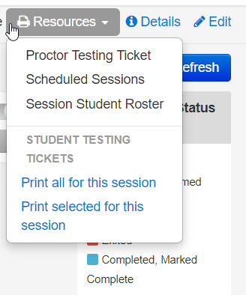
Print Testing Tickets
Students require testing tickets to log in to TestNav and access test content.
To print the student testing tickets, go to Testing > Students in Sessions > Add a Session > search for and select your Session, click Add Selected, then select the Resources drop-down.
Note: For live testing, testing tickets are secure and need to be tracked.

Slide 29
Poll Question
Will you have students participating in Human Reader or Human Signer sessions during the Infrastructure Trial?
Yes
No
I’m not sure

Slide 30
Human Read-Aloud and Human Signer Sessions
Test administrators who provide these accommodations will use their own computer and print their own proctor testing ticket to access a “test administrator” version of the test.
During operational testing, there will be one proctor testing ticket assigned to each Human Read-Aloud or Human Signer PAN Session—they are not unique to individual test administrators.
No responses should be entered into the test using a proctor testing ticket, as the responses will not be saved. (Students will sign in and respond using their student testing tickets.)

Slide 31
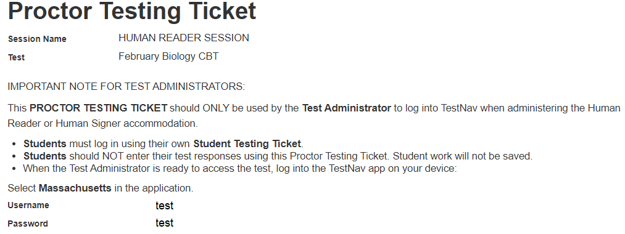
Proctor Testing Tickets
Sample Proctor Testing Ticket for Human Reader/Signer accommodation

Slide 32
Student Testing Tickets for Human Read-Aloud/Human Signer, TTS

Slide 33
Demonstrations
Unlock/Lock Sessions

Slide 34
Unlock PAN Sessions
On the Students in Sessions screen, while looking at your selected Session, you can unlock each test session by sliding the lock bar to the right.

Slide 35
Unlock Individual Students’ Tests
Students’ tests can also be unlocked one at a time if needed. This is done by selecting the lock icon next to each student’s name.

Slide 36
Questions and Answers
Use the “Q&A” feature to ask questions.

Slide 37
3. Administration and Next Steps

Slide 38
Conducting the Trial
Technology coordinators will be responsible for:
Monitoring network performance for slowdowns or ISP bandwidth usage
Responding to technology/device issues that may arise
Ensuring ProctorCache software is running, if being used
Test coordinators will be responsible for:
Directing test administrators and students to testing locations
Distributing testing tickets
Monitoring administration
Infrastructure Trials should take approximately 60 minutes to administer.

Slide 39
Demonstrations
Monitoring PAN Sessions

Slide 40
Monitoring PAN Sessions
Test administrators can use the Students in Sessions page to monitor students as they progress through each test session.
The top of the Students in Sessions page contains a status bar for each test session.

Slide 41
Student Status Dashboard and Error Codes
The Students in Sessions page has an additional feature to monitor students’ testing status.
A link will appear next to the status bar for each test session.
(the feature is not available if there are more than 100 students in the session)

Slide 42
Student Status Dashboard and Error Codes
A dashboard will open in a separate tab in the browser.
This dashboard will allow users to see all students in that test session and their activity/testing status and any error codes on a student's device, as well as the battery level of each testing device.
Error Codes: https://support.assessment.pearson.com/TN/1000s---connectivity-save-warning-and-error-codes-16908309.html

Slide 43
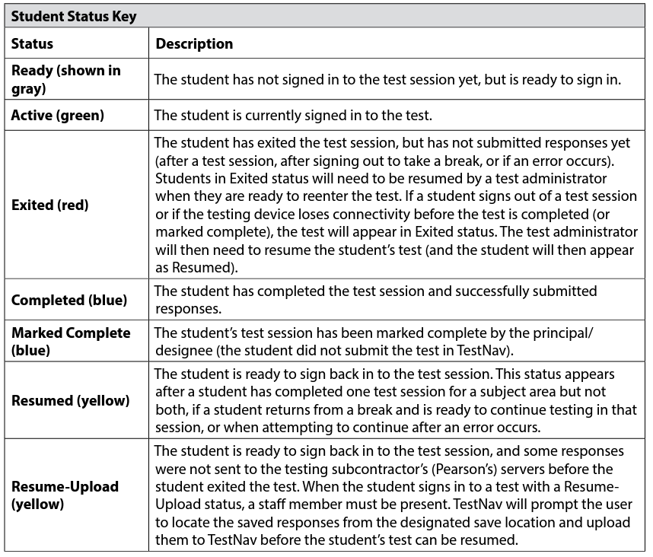
Key to Student Statuses for Students in PAN Sessions (Appendix B of the CBT TAM)

Slide 44
Resuming Student Tests
Sometimes a student will be exited from TestNav after they begin testing and will need to log back in.
Examples: user error, technology issues
Students must be in a “Ready”, “Resumed”, or “Resumed Upload” status in order to log in to TestNav.
If a student is in “Exited” status, and needs to get back in to TestNav, they will need to be Resumed by the Test Administrator.
Refer to the Resuming Student Tests video on the MCAS Resource Center for a demonstration of resuming student tests.

Slide 45
Resume-Upload
If a student is being resumed from an “Active” status in PAN, “Resume Upload” will be the only available option. This is to alert test administrators that there has been an abnormal exit such as the device being powered off.
Select “Resume Upload” in PAN
Select “Resume” in PAN
The student can also log in when in “Resume Upload”, but a message will appear on the student’s screen that gives the option of navigating to a Saved Response File. You can select “Skip Upload” on this message.
If you encounter any issues, call the MCAS Service Center.

Slide 46
Mark Students’ Tests Complete
Students will show in Complete status when they submit their responses in TestNav.
Test coordinators will need to mark complete a student test when a student has not finished testing in the usual manner or has not submitted their responses correctly.
Marking a test complete indicates the student is DONE with testing.
A test session cannot be stopped until all students have a status of Complete or Marked Complete.
On the Mark Student Test Complete page, you must enter a reason.

Slide 47
Stop PAN Sessions
Before a PAN session can be stopped, all students in that Session must either have the status of Complete or Marked Complete.
You may need to remove any students in Ready status from the PAN Session who did not log in to the test.
Once all students are in a Completed or Marked Complete status, select the Stop Session button on the Students in Sessions page.
Refer to the Marking Student Tests Complete video on the MCAS Resource Center for a demonstration of marking student tests complete and stopping a PAN Session.

Slide 48
After the Infrastructure Trial
Meet/debrief with technology coordinators and test administrators.
Collect any notes regarding need for support from the MCAS administration team, and share with the district test coordinator if applicable.
If any issues come up:
Report any issues that cannot be resolved to the MCAS Service Center.
Encourage technology coordinators to schedule a technology support call.

Slide 49
Questions and Answers
Use the “Q&A” feature to ask questions.

Slide 50
4. Resources, Support, and Next Steps

Slide 51
Resources in the MCAS Resource Center
Resource | Location
Infrastructure Trial Readiness Guide, including Best Practices for CBT Set-Up, Administration, and Troubleshooting | mcas.pearsonsupport.com/manuals (“PearsonAccess Next Guidance” drop-down)
Infrastructure Trial training modules | mcas.pearsonsupport.com/training
Student tutorial and practice tests | mcas.pearsonsupport.com/student
TestNav8 and PearsonAccess^{next} User Guides | mcas.pearsonsupport.com/technology-setup (“User Guides” drop-down)
Guide to the SR/PNP Process | mcas.pearsonsupport.com/manuals (“PearsonAccess Next Guidance” drop-down)
Technology Specifications | mcas.pearsonsupport.com/technology-setup (“Technology Guidelines” drop-down)
Accessibility and accommodations guidance and modules | mcas.pearsonsupport.com/manuals (“Accessibility and Accommodations Guidance” drop-down)

Slide 52
Additional Resources on the DESE MCAS website
Resource | Description
Home page | Access MCAS headlines and links to MCAS site (e.g., test schedule, test designs, training)
Student Assessment Updates | Biweekly email with important updates about the MCAS program If you do not already receive this email, subscribe at this link: http://eepurl.com/ghSOhH
Sample materials from schools | Review materials developed by Swampscott Public Schools and other schools that can be helpful in preparing for an Infrastructure Trial.

Slide 53
Upcoming Training Sessions
Date | Session | Audience
Tuesday, January 30 and Thursday, February 1, 9:30 – 11:00 a.m. | MCAS Accessibility and Accommodations | Principals, test coordinators, special education administrators and supervisors, test administrators
Wednesday, January 31, 9:30 – 11:15 a.m. | MCAS Test Security and Administration Protocols – Returning Staff | Principals, test coordinators, and test administration teams
Friday, February 2, 9:30 – 11:30 a.m. | MCAS Test Security and Administration Protocols – New Staff | Principals, test coordinators, and test administration teams
Monday, February 5, 9:30 – 11:00 a.m. | Pre-Administration Tasks for Technology Staff | Technology coordinators
Registration for training sessions available now: www.doe.mass.edu/mcas/training.html
After each session is delivered, a recording of the session and the slides will be posted at mcas.pearsonsupport.com/training/ approximately one week later.

Slide 54
Upcoming Training Sessions
Date | Session | Audience
Tuesday, February 27, 9:30 – 11:00 a.m. | Tasks in PearsonAccess Next Before Testing | Principals and test coordinators
Thursday, February 29, 9:30 – 11:00 a.m. | PAN Tasks for Accessibility Features and Accommodations | Principals, MCAS test coordinators, special education administrators and supervisors, and test administrators administering accessibility features and accommodations
Tuesday, March 12, 9:30 – 11:00 a.m. | Tasks in PAN During Testing | Principals and test coordinators
Thursday, March 14, 9:30 – 10:45 a.m. | Tasks in PAN After Testing | Principals and test coordinators
Registration for training sessions available now: www.doe.mass.edu/mcas/training.html
After each session is delivered, a recording of the session and the slides will be posted at mcas.pearsonsupport.com/training/ approximately one week later.

Slide 55
Next Steps
Today: Complete the evaluation form.
Responses are associated with the name and email address used to log in.
Email your input to mcas@doe.mass.edu if you have problems accessing or completing the form.
Within one week:
Receive an email with the Q&A from this session
Recording will be available

Slide 56
Email and Phone Support
MCAS Service Center
DESE Student Assessment Services
Questions on logistics and technology (e.g., PearsonAccess Next, SR/PNP, TestNav)
Web: mcas.pearsonsupport.com
Email: mcas@cognia.org
Phone: 800-737-5103
Schedule Technology Support Call
Policy questions (e.g., student participation, accommodations, “I have a student who…”)
Web: www.doe.mass.edu/mcas
Email: mcas@doe.mass.edu
Phone: 781-338-3625

Slide 57
5. Live “Sandbox Time”

Slide 58
Poll Question
Which demonstrations would you like to see again?
Prepare Sessions
Accessing Session Student Roster
Print Testing Tickets
Student testing ticket vs. Proctor testing ticket
Start Sessions
Unlock/lock sessions
Monitoring PAN Sessions

Slide 59
Poll Question
Which demonstrations would you like to see again?
Accessing the practice tests
PAN training site vs. live site
Generating sample students
Creating PAN Sessions
Updating a student record
Add an accommodation to a sample student
Add student to PAN Session
Human Reader/Human Signer Sessions

Slide 60
THANK YOU
The Office of Student Assessment Services
781-338-3625
mcas@doe.mass.edu
www.doe.mass.edu/mcas
135 Santilli Highway, Everett, MA 02149

